Slide 1
RUM Analytics Platform
Notes:
Hello! Our names are Irixa and Antonio! We are UPRM students working on our capstone project.

Slide 2


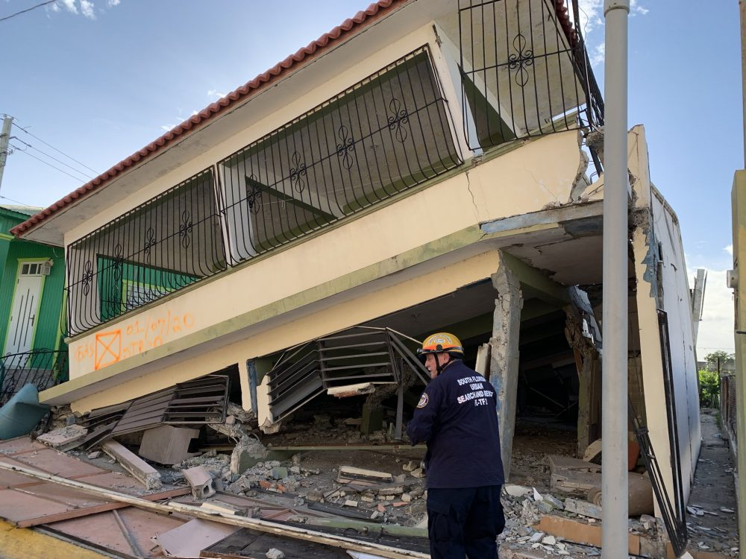
Source: Milagros Rodriguez
Source: Miami Fire Rescue
Source: Erika P. Rodríguez for The New York Times
Notes:
It’s easy to see PR has not had it easy in the last couple of years. From category 5 hurricanes, to earthquake, to civil protests, there has been something to disrupt almost every semester for the last 3 years. These events affect how the school year has run, and more importantly it has affected the student body in innumerable ways. If an educational institution wants to define its success, shouldnt it do so by its students and their performance. But, how does an institution help students in these situations?

Slide 3
Data analytics
Looking at the student’s performance we can identify when they face their hardest moments
Notes:
Well, first we need to identify the problems they face. RUM Analytics Platform uses data analytics and correlate dips in performance, measured via a drop in gpa, to identify when a problem was faced. But that’s not all since doing this for 1 student is easy. How do do it for all of them?

Slide 4
22,195 students
793,615
50%
That’s a lot of users
And a lot of grades
Of the story
Notes:
when looking at the records for the last 10- years, there’s a lot of students. Data analytics really is key to make this work since there is a lot of data to comb through. That said, this data only tells us one side of the story. In order to fully understand the problems the student body faces we need some more direct input from them. this way we can identify anything that puts a damper on a student’s performance.

Slide 5
Our process is easy
Identify
Ask
Analyze
Identify dips in performance via GPA
Ask student body what their troubles were
Analyze steps to take to aid student learning.
Notes:
With RUM Analytics Platform, we look at the student’s performance and we ask the student body to submit their perceptions for each identified problem semester. With this information we can analyze if the student’s perceptions are accurate and we can provide clarity on the correlations between events and performance.

Slide 6
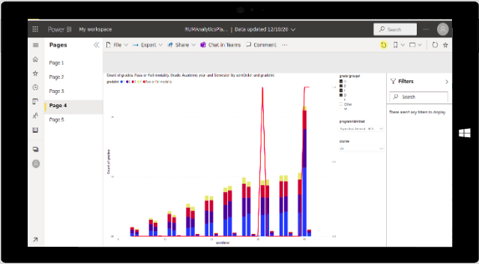
Place your screenshot here
Visualization
Once the data is consumed, RUM Analytics Platform will help you visualize it for easier analysis and digestibility.
Notes:
This helps the institution share this data and discuss strategies to help the student body learn.

Slide 7
Every student can learn Just not on the same day Or in the same way.
-George Evans

Slide 8
Thanks!
Will you embrace data?
You can find us at:
https://manathonys.github.io/Capstone/
Special thanks to all the people who made and released these awesome resources for free:
-Presentation template by SlidesCarnival
-Photographs by Unsplash

